Slide 1

Chapter 9
Software Testing: A Craftsman’s Approach, 4th Edition Chapter 9 Data Flow Testing
Dataflow and Slice Testing

Slide 2
Outline
Introduction and overview
Dataflow testing
  define and use nodes
  define/use paths
  examples
  test coverage lattice
Slice testing
  basic definitions
  static or dynamic slices?
Slice splicing

Slide 3
Dataflow Testing
Often confused with "dataflow diagrams“.
Main concern: places in a program where data values are defined and used.
Static (compile time) and dynamic (execution time) versions.
Static: Define/Reference Anomalies on a variable that
  is defined but never used (referenced)
  is used but never defined
  is defined more than once
Starting point is a program, P, with program graph G(P), and the set V of variables in program P.
"Interesting" data flows are then tested as separate functions.

Slide 4
Definitions
Given a program, P, with a set V of variables in P, and the program graph G(P), Node n ∈ G(P) is
  a defining node of the variable v ∈ V, written as DEF(v, n), iff the value of the variable v is defined at the statement fragment corresponding to node n.
  a usage node of the variable v ∈ V, written as USE(v, n), iff the value of the variable v is used at the statement fragment corresponding to node n.
A usage node USE(v, n) is a predicate use (denoted as P-use) iff the statement n is a predicate statement; otherwise, USE(v, n) is a computation use (denoted C-use).

Slide 5
More Definitions
A definition-use path with respect to a variable v (denoted du-path) is a path in the set of all paths in P, PATHS(P), such that for some v ∈ V, there are define and usage nodes DEF(v, m) and USE(v, n) such that m and n are the initial and final nodes of the path.
A definition-clear path with respect to a variable v (denoted dc-path) is a definition-use path in PATHS(P) with initial and final nodes DEF (v, m) and USE (v, n) such that no other node in the path is a defining node of v.

Slide 6
Example: first part of the Commission Program
1. Program Commission (INPUT,OUTPUT)
2. Dim locks, stocks, barrels As Integer
3. Dim lockPrice, stockPrice, barrelPrice As Real
4. Dim totalLocks, totalStocks, totalBarrels As Integer
5. Dim lockSales, stockSales, barrelSales As Real
6. Dim sales, commission As Real
7. lockPrice = 45.0
8. stockPrice = 30.0
9. barrelPrice = 25.0
10. totalLocks = 0
11. totalStocks = 0
12. totalBarrels = 0
13. Input(locks)
14. While NOT(locks = -1)
15. Input(stocks, barrels)
16. totalLocks = totalLocks + locks
17. totalStocks = totalStocks + stocks
18. totalBarrels = totalBarrels + barrels
19. Input(locks)
20. EndWhile
21. Output(“Locks sold: “, totalLocks)
22. Output(“Stocks sold: “, totalStocks)
23. Output(“Barrels sold: “, totalBarrels)

Slide 7
Rest of Commission Problem
23. Output(“Barrels sold: “, totalBarrels)
24. lockSales = lockPrice * totalLocks
25. stockSales = stockPrice * totalStocks
26. barrelSales = barrelPrice * totalBarrels
27. sales = lockSales + stockSales + barrelSales
28. Output(“Total sales: “, sales)
29. If (sales > 1800.0)
30. Then
31. commission = 0.10 * 1000.0
32. commission = commission + 0.15 * 800.0
33. commission = commission + 0.20 *(sales-1800.0)
34. Else If (sales > 1000.0)
35. Then
36. commission = 0.10 * 1000.0
37. commission = commission + 0.15 *(sales-1000.0)
38. Else
39. commission = 0.10 * sales
40. EndIf
41. EndIf
42. Output(“Commission is $”, commission)
43. End Commission

Slide 8
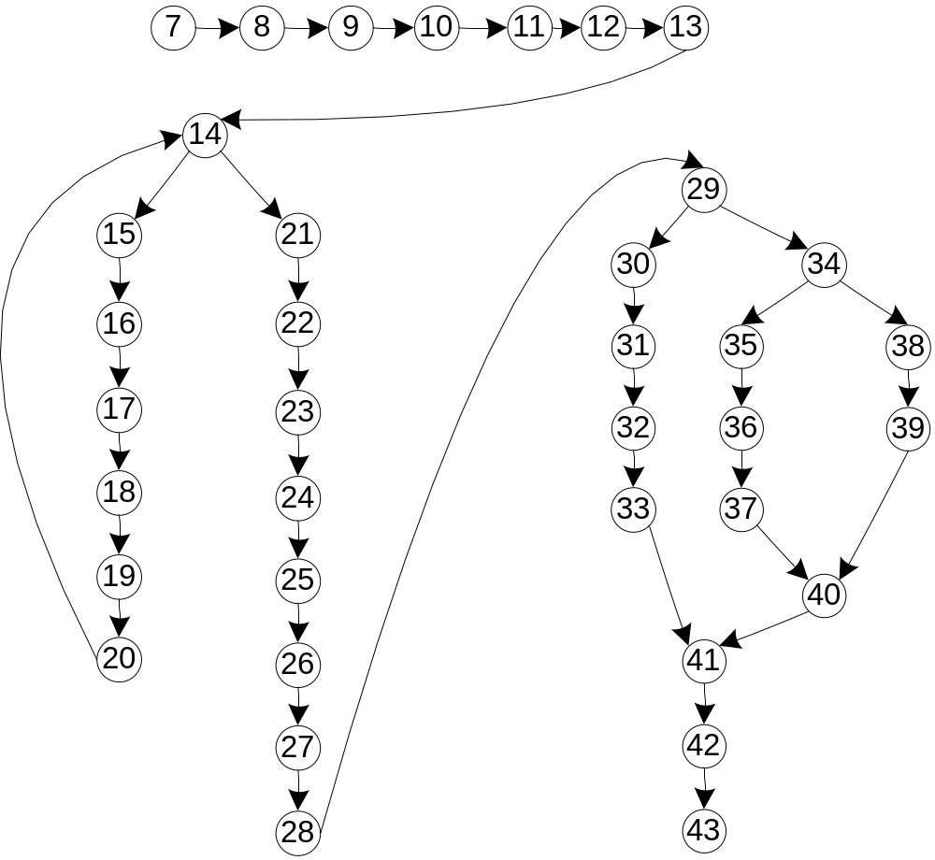
Commission Program Graph

Slide 9
Selected Def and Use Nodes
Variable | Defined at Node | Used at Node
lockPrice | 7 | 24
totalLocks | 10, 16 | 16, 21, 24
locks | 13, 19 | 14, 16
lockSales | 24 | 27
sales | 27 | 28, 29, 33, 34, 37, 38
commission | 31, 32, 33, 36, 37, 38 | 32, 33, 37, 41

Slide 10
Exercise: Identify Def and Use Nodes
Variable | Defined at Node | Used at Node
stockPrice
totalStocks
locks | 13, 19 | 14, 16
stockSales
sales | 27 | 28, 29, 33, 34, 37, 38
commission | 31, 32, 33, 36, 37, 38 | 32, 33, 37, 41

Slide 11
Define/Use Paths (du-paths) for locks
p1 = <13, 14>
p2 = <13, 14, 15, 16>
p3 = <19, 20, 14>
p4 = <19, 20, 14, 15, 16>
(all are definition clear)

Slide 12
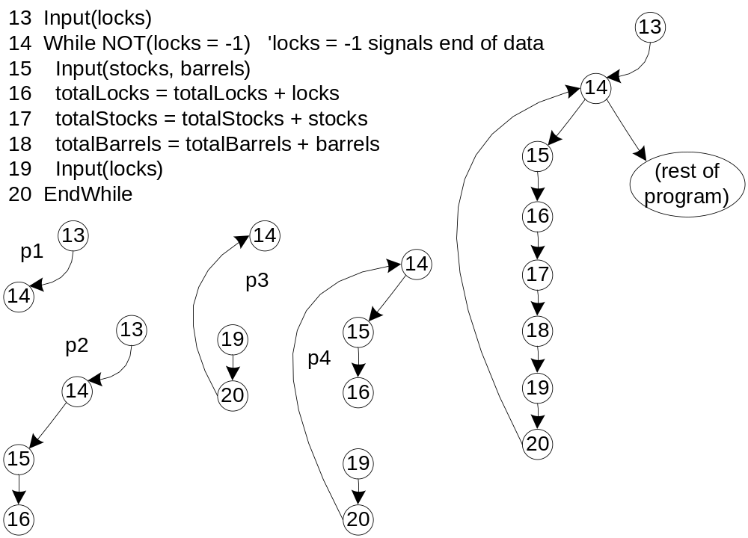

Slide 13
Define/Use Test Cases
Technique: for a particular variable,
  find all its definition and usage nodes, then
  find the du-paths and dc-paths among these.
  for each path, devise a "suitable" (functional?) set of test cases.
Note: du-paths and dc-paths have both static and dynamic interpretations
  Static: just as seen in the source code
  Dynamic: must consider execution-time flow (particularly for loops)
Definition clear paths are easier to test
  No need to check each definition node, as is necessary for du-paths

Slide 14
Coverage Metrics Based on du-paths
In the following definitions, T is a set of paths in the program graph G(P) of a program P, with the set V of variables.
The set T satisfies the All-Defs criterion for the program P iff for every variable v ∈ V, T contains definition-clear paths from every defining node of v to a use of v.
The set T satisfies the All-Uses criterion for the program P iff for every variable v ∈ V, T contains definition-clear paths from every defining node of v to every use of v, and to the successor node of each USE(v, n).

Slide 15
Coverage Metrics Based on du-paths
(continued)
The set T satisfies the All-P-Uses/Some C-Uses criterion for the program P iff for every variable v ∈ V, T contains definition-clear paths from every defining node of v to every predicate use of v; if a definition of v has no P-uses, a definition-clear path leads to at least one computation use.

Slide 16
Coverage Metrics Based on du-paths
(continued)
The set T satisfies the All-C-Uses/Some P-Uses criterion for the program P iff for every variable v ∈ V, T contains definition-clear paths from every defining node of v to every computation use of v; if a definition of v has no C-uses, a definition-clear path leads to at least one predicate use.

Slide 17
Coverage Metrics Based on du-paths
(concluded)
The set T satisfies the All-du-paths criterion for the program P iff for every variable v ∈ V, T contains definition-clear paths from every defining node of v to every use of v and to the successor node of each USE(v, n), and that these paths are either single-loop traversals or cycle-free.

Slide 18
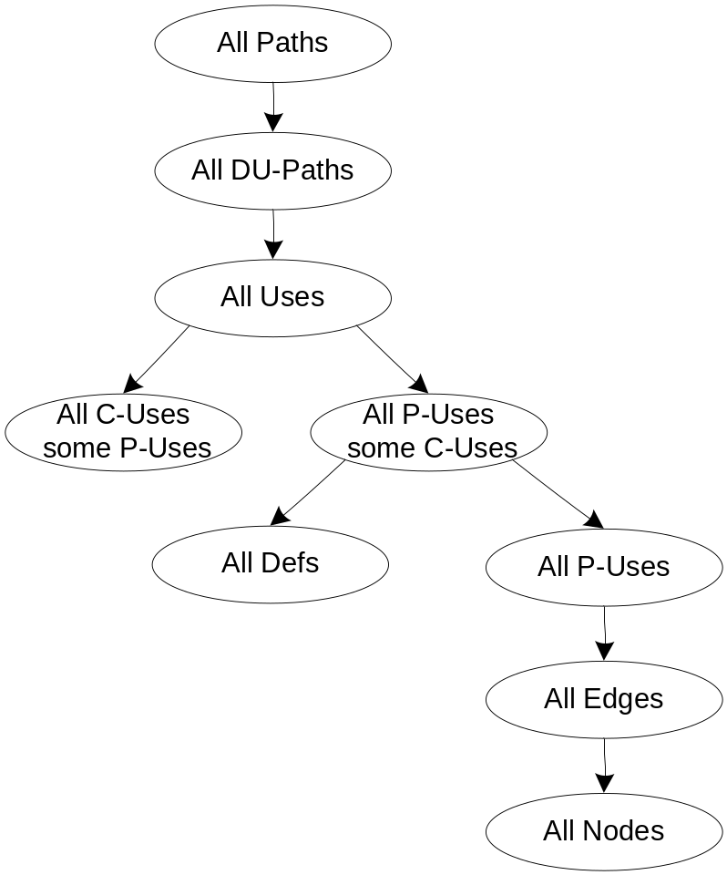
Rapps-Weyuker Coverage Subsumption
S. Rapps and E. J. Weyuker
“Selecting Software Test Data Using Data Flow Information”
IEEE Transactions of Software Engineering , vol 11 no 4
IEEE Computer Society Press, Washington, D. C. ,
April 1985, pp 367 - 375.

Slide 19
Exercise: Where does the “All definition-clear paths” coverage metric fit in the Rapps-Weyuker lattice?

Slide 20
Dataflow Testing Strategies
Dataflow testing is indicated in
  Computation-intensive applications
  “long” programs
  Programs with many variables
A definition-clear du-path represents a small function that can be tested by itself.
If a du-path is not definition-clear, it should be tested for each defining node.

Slide 21
Slice Testing Definitions
Starting point is a program, P, with program graph G(P), and the set V of variables in program P. Nodes in the program graph are numbered and correspond to statement fragments.
Definition: The slice on the variable set V at statement fragment n, written S(V, n), is the set of node numbers of all statement fragments in P prior to n that contribute to the values of variables in V at statement fragment n.
This is actually a “backward slice”.
Exercise: define a “forward slice”.

Slide 22
Fine Points
"prior to" is the dynamic part of the definition.
"contribute" is best understood by extending the Define and Use concepts:
  P-use: used in a predicate (decision)
  C-use: used in computation
  O-use: used for output
  L-use: used for location (pointers, subscripts)
  I-use: iteration (internal counters, loop indices)
  I-def: defined by input
  A-def: defined by assignment

Slide 23
Fine Points (continued)
usually, the set V of variables consists of just one element.
can choose to define a slice as a compilable set of statement fragments -- this extends the meaning of "contribute"
because slices are sets, we can develop a lattice based on the subset relationship.

Slide 24
In the program fragment
13. Input(locks)
14. While NOT(locks = -1)
15. Input(stocks, barrels)
16. totalLocks = totalLocks + locks
17. totalStocks = totalStocks + stocks
18. totalBarrels = totalBarrels + barrels
19. Input(locks)
EndWhile
There are these slices on locks (notice that statements 15, 17, and 18 do not appear):
  S1: S(locks, 13) = {13}
  S2: S(locks, 14) = {13, 14, 19, 20}
  S3: S(locks, 16) = {13, 14, 19, 20}
  S4: S(locks, 19) = {19}

Slide 25
Lattice of Slices
Because a slice is a set of statement fragment numbers, we can find slices that are subsets of other slices.
This allows us to “work backwards” from points in a program, presumably where a fault is suspected.
The statements leading to the value of commission when it is output are an excellent example of this pattern.
Some researchers propose that this is the way good programmers think when they debug code.

Slide 26
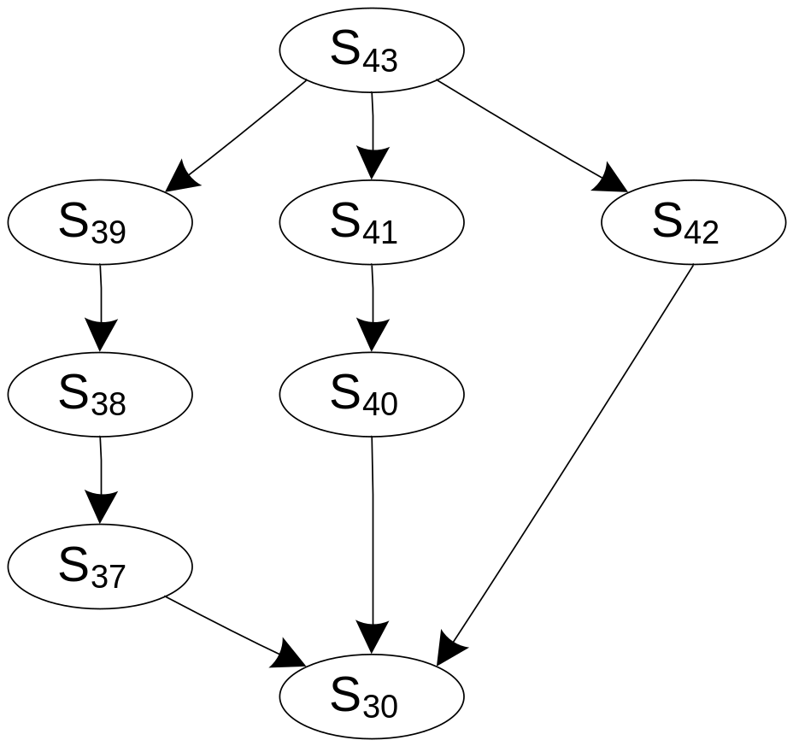
Partial Lattice on Commission

Slide 27
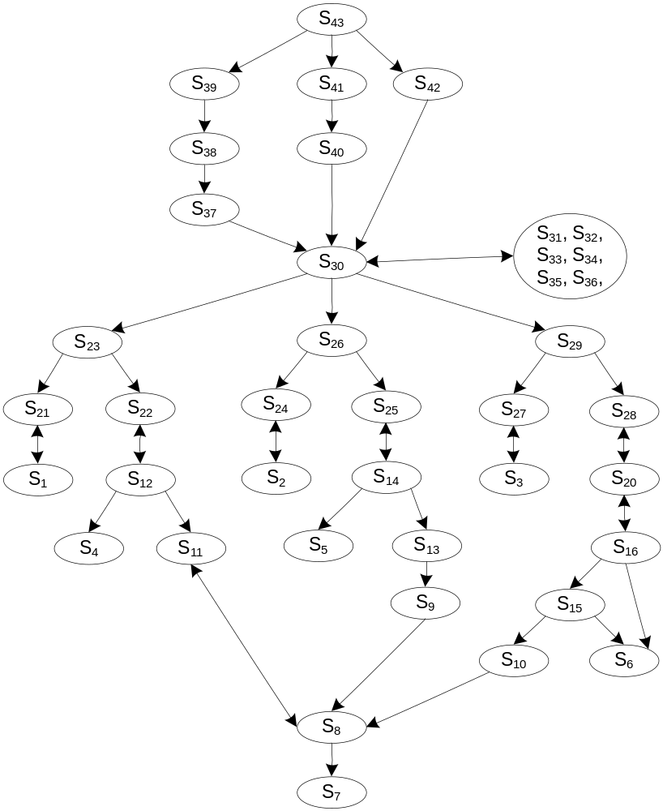
Complete Lattice on Commission

Slide 28
Programming with Slices
One researcher suggests the possibility of “slice splicing”:
  Code a slice, compile and test it.
  Code another slide, compile and test it, then splice the two slices.
  Continue until the whole program is complete.
Exercise: in what ways is slice splicing distinct from agile (bottom up) programming?

